Slide 1




TR# 2017325

Slide 2

AGENDA
Your HR Support Team
T-Mobile Benefits
Performance Improvement Planning
Q&A
2 – HR Presentation
T-Mobile confidential and proprietary information. Not for customer distribution.

Slide 3

Your HR Support
Team
T-Mobile confidential and proprietary information. Not for customer distribution.

Slide 4
WHO WE ARE & HOW WE CAN HELP
The Employee Success Partner and the Talent Scout are members of your T-Mobile team.
Employee Success Partners and Talent Scouts are to assist with the following:
Strategically achieve business and career objectives
Partnership in applying consistent policies and procedures
Leave of Absences and Accommodations
Zendesk, a great HR resource
4 – HR Presentation
T-Mobile confidential and proprietary information. Not for customer distribution.
Notes:
The ESP & Talent Scout provide the tools, resources, and information necessary to attract, hire, and develop and retain top talent.
Zendesk:
When it comes to information about pay, benefits, PTO or other HR-related areas that are important to your personal and professional well-being, Zendesk will help you get answers.
You can access Zendesk by using the icon on your desktop.
Zendesk offers a full suite of options to get you the assistance you need.
Like to problem solve on your own? You can self-serve. Prefer to chat? Connect with an Employee Care Specialist and get real-time answers.
Plus, you'll get email updates so you know what's going on every step of the way.
Facilitator Note: when it comes to detailed HR questions, the trainers should refer the Mobile Associates to their HR resource, not their hiring store manager.

Slide 5
BE SMART
We are fun and casual, but we are also professional
T-Mobile has a ZERO TOLERANCE policy for Harassment & Discrimination
We also do not tolerate unlawful retaliation or intimidation
5 – HR Presentation
T-Mobile confidential and proprietary information. Not for customer distribution.
Notes:
We play in a very fun and casual space, but it’s also a professional workspace so you’re probably not surprised when I say that RESPECT is key here at T-Mobile.
You also won’t be surprised to hear that we do not tolerate harassment, discrimination, retaliation and intimidation.
While that may seem like a no-brainer, it’s important that we set that foundation that you will be treated with respect here at T-Mobile.
You’ll be going through some additional training on this topic now and each year. It’s that important.
You’ll be receiving additional training on these topics, but feel free to contact your HR crew member or supervisor with any questions
HR handbook on T-Nation: https://tmobileusa.sharepoint.com/sites/policies/TMUS%20Policies/EmployeeHandbook.pdf
Code of conduct; https://tmobileusa.sharepoint.com/sites/policies/TMUS%20Policies/Code%20of%20Business%20Conduct.pdf#search=code%20of%20conduct

Slide 6
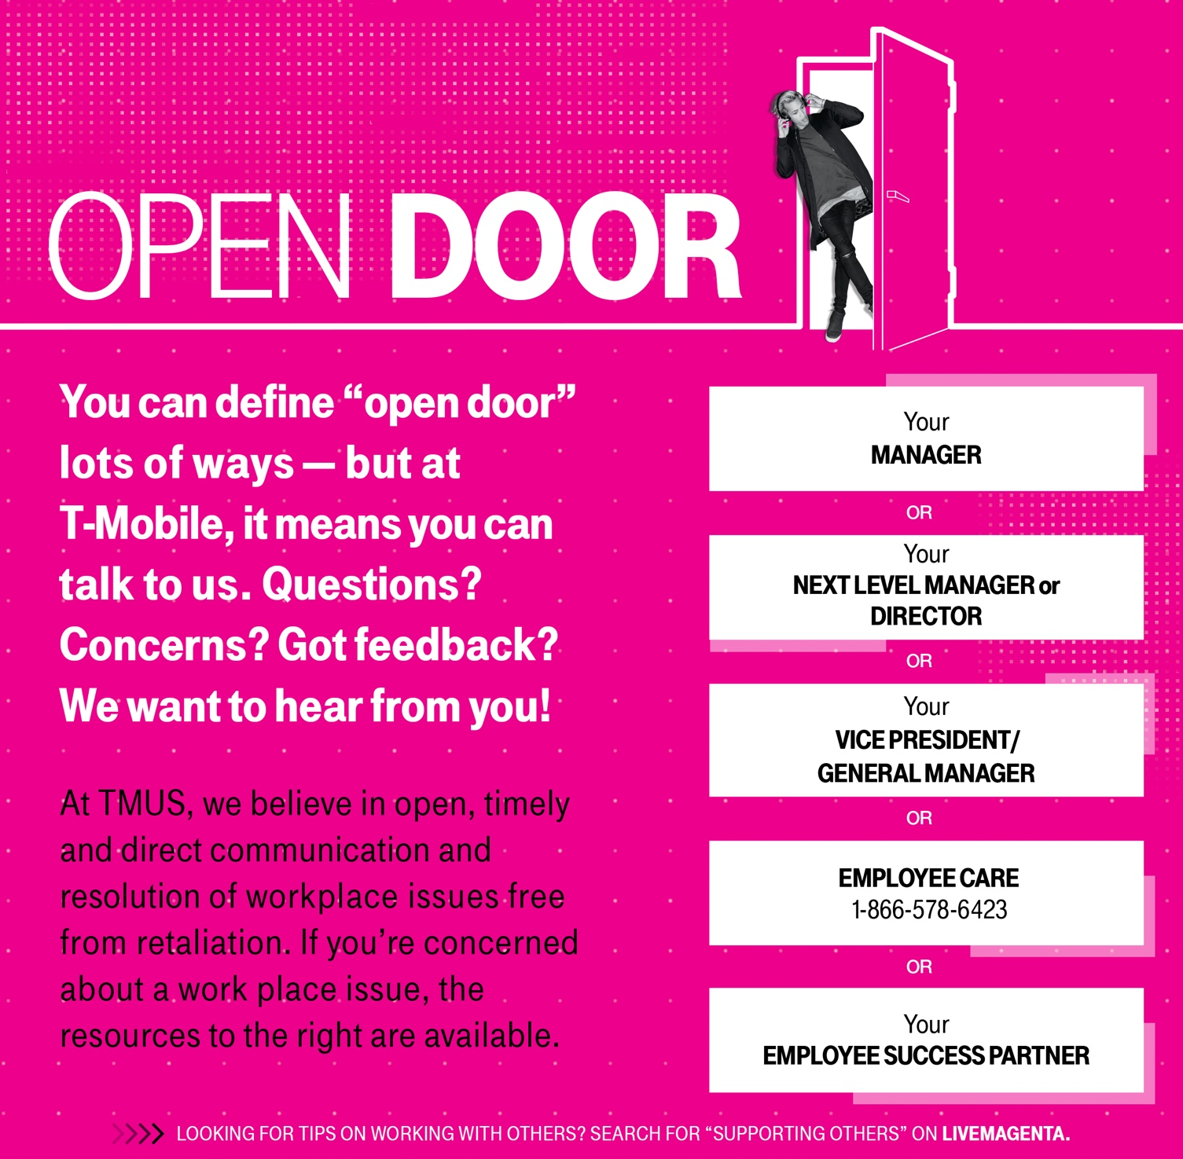
6 – HR Presentation
T-Mobile confidential and proprietary information. Not for customer distribution.
Notes:
Our door is always open to help you with any questions, concerns or feedback you may have.
There are many individuals at T-Mobile willing to help beginning with your manager.
You can find this posted in the backroom of every store!
Our phone numbers are listed there as well for your convenience.

Slide 7
T-Mobile
Benefits
T-Mobile confidential and proprietary information. Not for customer distribution.

Slide 8
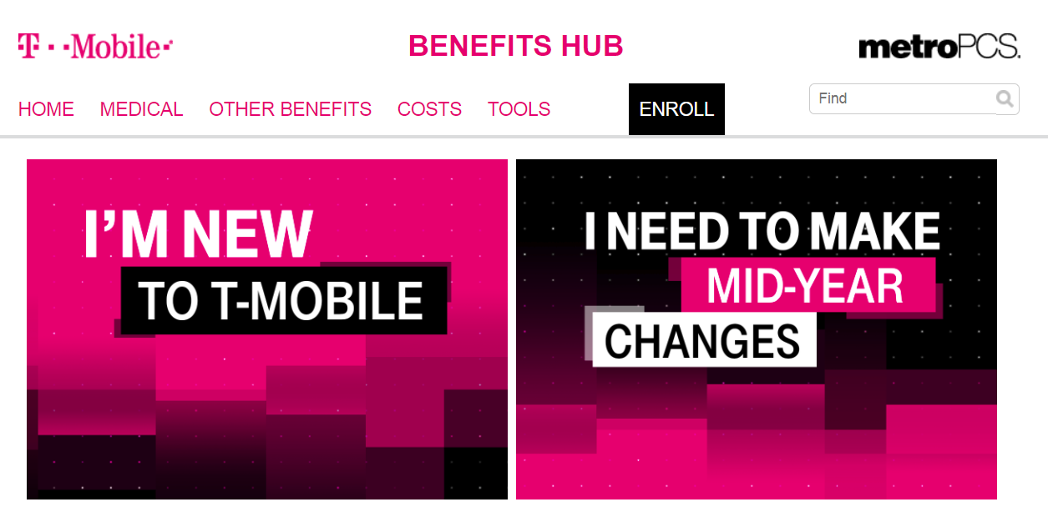
T-MOBILE BENEFITS HUB
8 – HR Presentation
T-Mobile confidential and proprietary information. Not for customer distribution.
Notes:
First class employees deserve first class health benefits, so you know we’ve got Team Magenta well covered.
You can see all your benefits information in one location, The Benefits Hub.
Employees can see all the information about the awesome medical, dental and vision plans, as well as flexible spending accounts (FSAs).
You can also, find information on the specialty services offered like Teladoc and Compass Health Pros. Because, you know, the Un-carrier always goes the extra mile.

Slide 9
BENEFITS GUIDE
Working for T-Mobile includes great benefits, discounts, and perks for you and your family.
Medical, Dental & Vision Coverage
Paid Parental Leave, Adoption/Surrogacy Assistance, Free Money for Childcare
Stock & 401(k) Plans
Tuition Assistance
Mobile Service Discount & Discounts + Perks Program
Employee Referral Program
9 – HR Presentation
T-Mobile confidential and proprietary information. Not for customer distribution.
Notes:
The Un-carrier takes care of its own! Working for T-Mobile includes some great benefits and discounts + perks for you and your family. In addition to medical, dental and vision coverage, you’ll have access to benefits for your health, your future, your life and your extras.
Planning a baby? Check out our Paid Parental Leave, Free Money for Childcare, and Adoption/Surrogacy Assistance.
More interested in your finances? Learn about our Stock and 401(k) plans!
Looking for Tuition Assistance? Got that too.
For every-day discounts to help along the way take a look at our Mobile Service Discount and our Discounts + Perks program.
Employees are our best source for finding our next T-Mobile rock stars, our boots on the ground talent scouts! We have more than 2,000 job openings at any given time. We want your help finding the right people to fill those positions—which could mean $250 to $1,500 in your pocket if your referral gets hired! Check out the process!
play video - https://tmobileusa.sharepoint.com/portals/hub/_layouts/15/pointpublishing.aspx?app=video&p=p&chid=1c64bd44-46d2-4870-9e14-7f021f459b68&vid=62ac68c5-909d-4842-91ba-da614090cbde
T-Mobile offers a variety of benefits that are designed to make your life easier, provide you with great coverage that is affordable to you, and support your goals for the future.

Slide 10
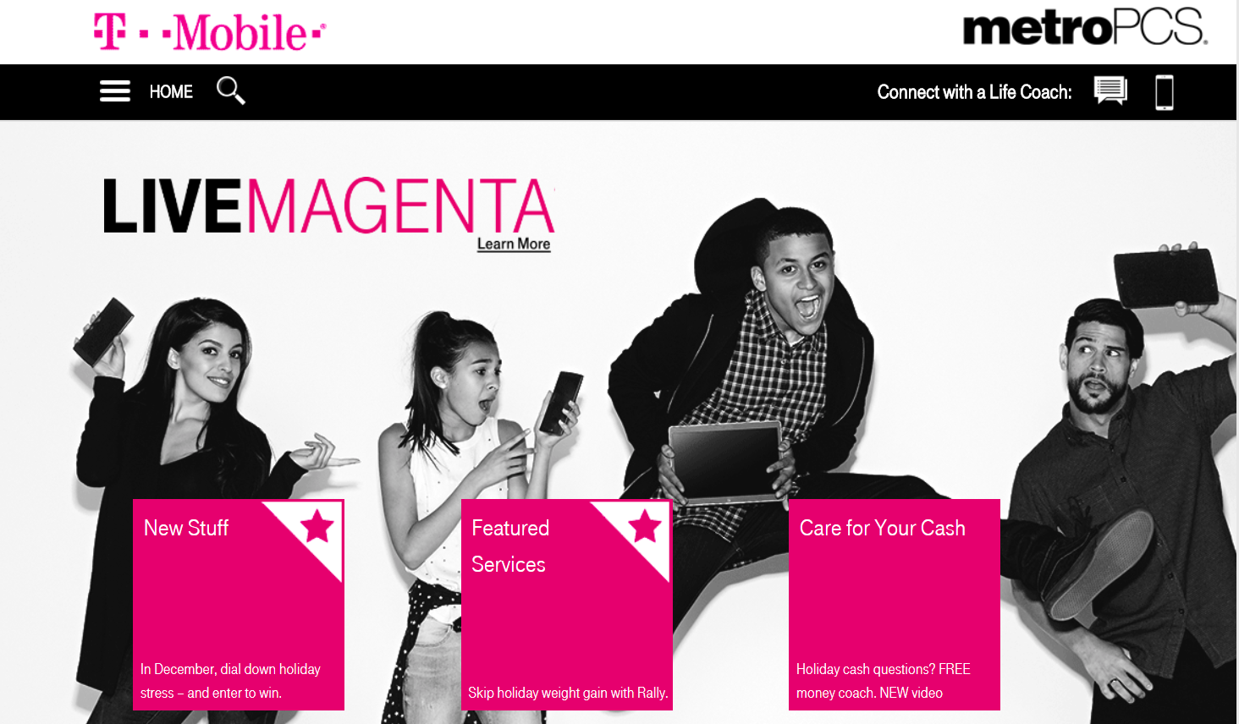
LIVE MAGENTA
When life happens…
money stressors, family issues, health challenges, you name it…
LiveMagenta's got the support you need..
10 – HR Presentation
T-Mobile confidential and proprietary information. Not for customer distribution.
Notes:
Life can be stressful. At some point or another all of us have faced stress.
It’s good to know that T-Mobile offers a robust program of resources for those difficult times. LiveMagenta, is a uniquely Un-carrier, custom, mobile experience for T-Mobile employees and their families to connect to expert personal coaching and support.
Get your own expert money coach, connect with a life coach, and use state‐of‐the‐art apps to work on your health, finances, resiliency, and more.
Many people don’t know that LiveMagenta has tons of useful articles that can help you be more effective at work and at home, everything from time management to parenting articles and so much more.
There’s even an app

Slide 11
TOTAL REWARDS PORTAL
What’s in it for you?
Pay
Incentives
Benefits
Stock (we are all shareholders)
Employee Mobile Service Discount
T-mobiletotalrewards.com
11 – HR Presentation
T-Mobile confidential and proprietary information. Not for customer distribution.
Notes:
The Total Rewards Portal shows you the dollar value of everything you get for changing the wireless industry.
We're talking pay, incentives, benefits, stock, savings, employee mobile service discount, and more.
It's like getting your own personal financial update—and, it's mobile.

Slide 12


Accelerate My Performance
12 – HR Presentation
T-Mobile confidential and proprietary information. Not for customer distribution.
Notes:
We only hire rock stars. So how are you gonna rock your job? Easy.
We provide the tools, training and coaching you need to be successful.
You deliver amazing performance and take care of our customers.
Our performance management system is called AMP or Amplify My Performance.
Your Leadership team will have conversations with you to let you know how you’re doing, what’s expected, and what you can work on.
You’ll also get recognized for a job well done and you’ll talk about where you want to go.
SYNC and INVEST conversations are a great opportunity to connect and plug in so you can be sure you’re set up for success.

Slide 13
T-Nation Resources
Benefits Hub
Live Magenta
Total Rewards Portal
Zendesk
13 – HR Presentation
T-Mobile confidential and proprietary information. Not for customer distribution.
Notes:
Remember, You have many resources available to you through T-Nation. Here are all that we covered today!
Please refer any HR related questions to Zendesk by using the icon on your desktop. Zendesk offers a full suite of options to get you the assistance you need. You can also self-serve, by chatting with an Employee Care Specialist and get real-time answers.

